Slide 1
Think Beyond Audit
Ara Chalabyan
MBA, ACCA, CIA, CRMA, CRISC
September 28, 2023
Ohrid

Slide 2
Здраво, како си?

Slide 4
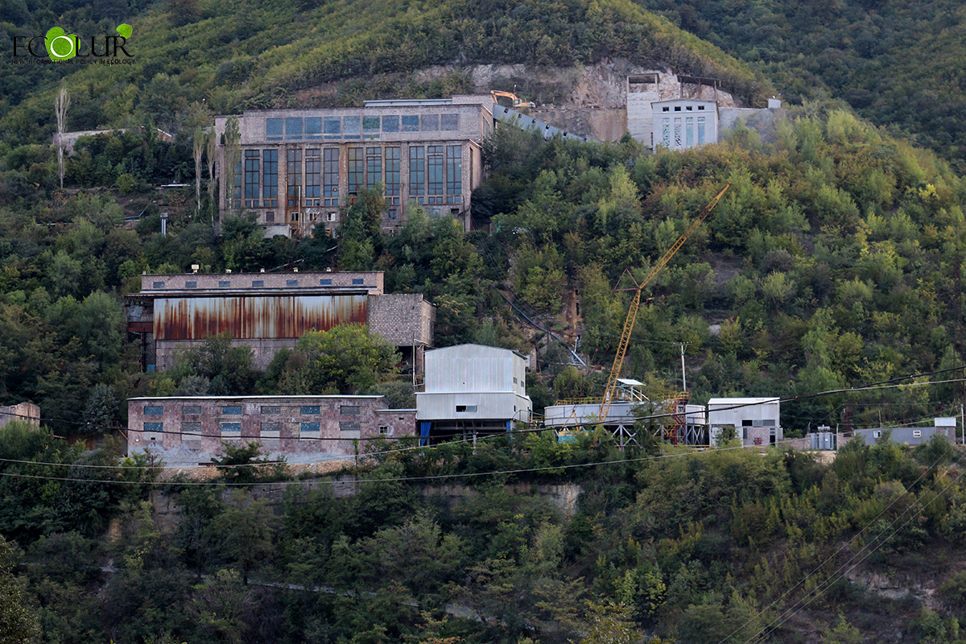
Soldier
Internal auditor
Credit Division Manager
Trade Finance Expert
Banking supervisor
Credit officer
Director Lending and Corp Fin
Risk manager
Professor
President
CAE
Consultant
CFO
Mining
Board member
CEO
Commerce
COO

Slide 5
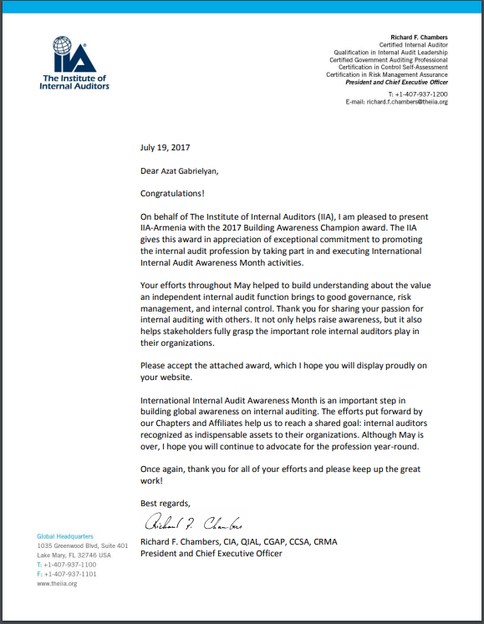
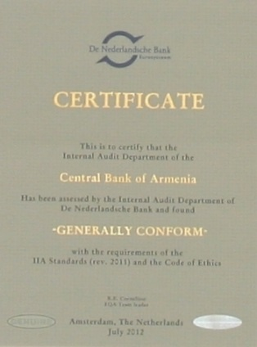
TEAM ACHIEVEMENTS
External Assessment 2012
External Assessment 2017
IIA-Armenia won Building Awareness Champion award in 2017 for promoting internal audit profession by taking part in and executing international Internal Audit Awareness Month activities

Slide 6
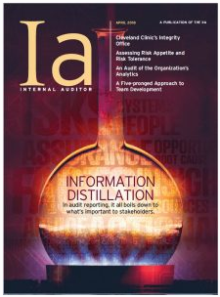
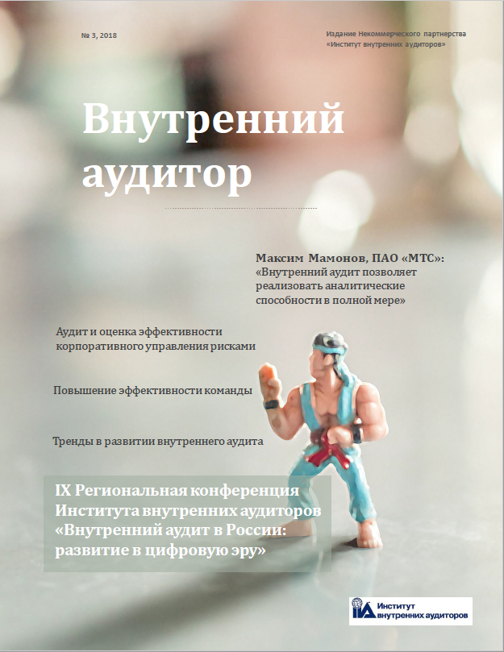
PERSONAL ACHIEVEMENTS
Outstanding Contributor
Ia Magazine 2018
Elevating Team Performance,
Internal Auditor Magazine and Внутренний аудитор
(IIA-Russia) magazine
Is the boss always right?
Cultural stereotypes. Fears of the boss
Excuses of a simple mortal
«Внутренний аудитор»
(IIA-Russia) magazine
Certificate of Excellence 2014
Teaching Excellence Award
2016
Teaching Excellence Award
2018

Slide 7
Do people really care about our achievements
or how we treat them

Slide 8
Think beyond YOURSELF

Slide 9
Think beyond your JOB RESPONSIBILITIES

Slide 10
Think beyond your PROFESSION

Slide 11
Individual Performance Linked to Overall Performance
Top-down
Carrying out tasks responsibly
Bottom-up
Taking additional responsibility
Valuable recommendations
Meeting audit and project deadlines
Quality of reports & working papers
Sound relationships and communication with colleagues
Responsibility
Efficiency
Fair-minded debater
Active
listener
Suppor-
ter
Collaboration
Internal
Contributing in discussions
Interactions
Feedback
External
Lecturing/speaking
IIA Armenia
Articles
Desired
team member
Interpersonal skills
Technical knowledge and tools
Internal audit standards, theory and methodology
Specific expertise
Visibility
Professional Development

Slide 12
Do you think beyond PAST audit issues?
Are you Happy?
Are your clients happy with your work?

Slide 13
Why do YOU work
CASH
CAREER
CAUSE

Slide 15
Is audit YOUR last job

Slide 17
What do YOU dream about

Slide 19
What drives YOU

Slide 21
What is the reason YOU wake up in the morning

Slide 22
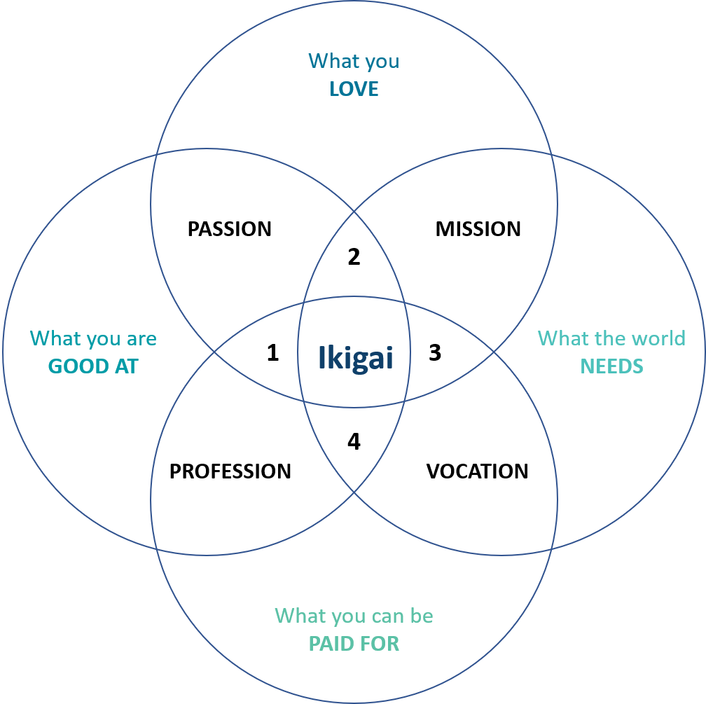
Ikigai - a reason for being

Slide 25
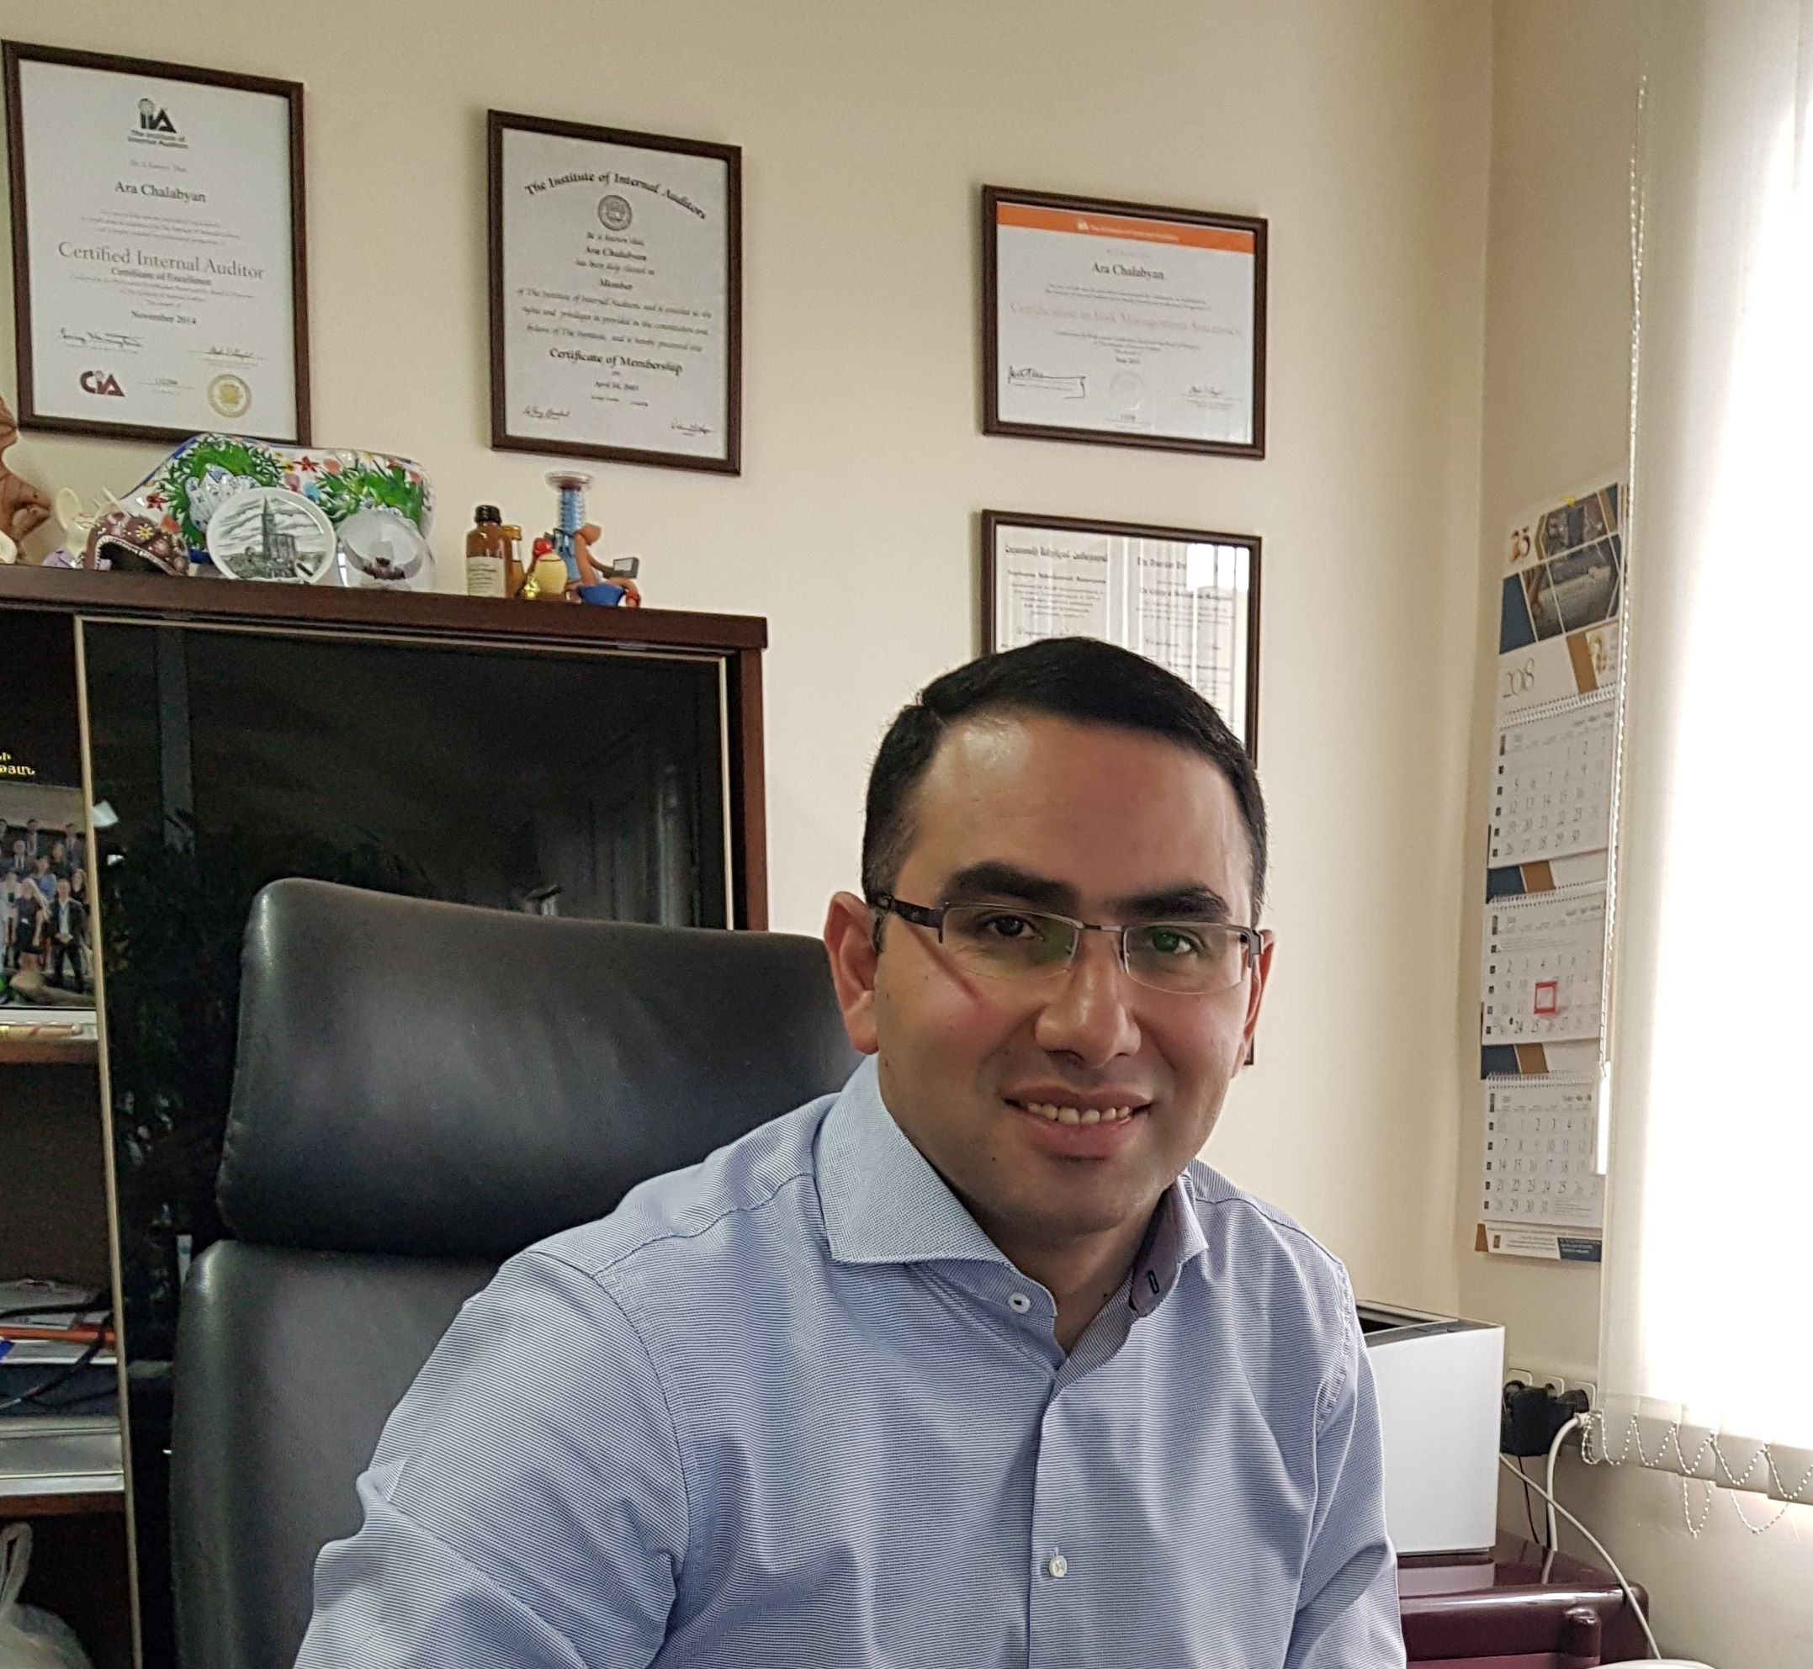

Slide 27
Ви благодарам!!

