Slide 1
Disclaimer:
This presentation has been prepared as general background information at the date of this presentation. The information in this presentation is provided in summary form only and does not purport to be complete.
Presentation is intended for educational purposes only and does not replace independent professional judgment.
The opinions expressed in this presentation and on the following slides are solely those of the presenter unless expressly stated to the contrary.

Slide 2
MAP | Kaspersky Cyberthreat real-time map
Bitdefender Threat Map
Notes:
Sliki
https://unsplash.com/

Slide 3
In 2008, just as the iPhone was coming out and the app economy was developing, only 7% of breaches involved compromised end-user devices
Source: Verizon, 2023

Slide 4
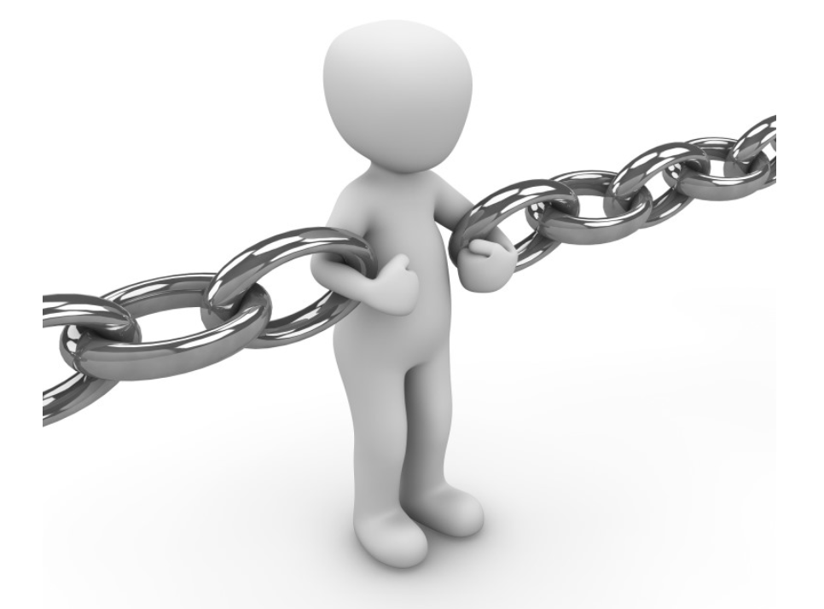
Yes, users are the (still) weakest point when it comes to cyber security

Slide 5
WHY DOES THIS HAPPEN ?
SO…. WHAT WE CAN DO?

Slide 6
WHY DOES THIS HAPPEN?
LACK OF KNOWLEDGE AND SKILLS
HUMAN NATURE - Unintentional error of omission
Caused by:
distracted
tired
deadline pressure
stressed
burned out
EXAMPLES - Common Threats
INTENTIONAL - “malicious insider”

Slide 7
Common Threats
Phishing: Attempt by cybercriminals to steal personal information or break into online accounts by using deceptive emails, ads, links, or messages
Malware: Malicious code distributed by cybercriminals in email messages to infect one or more devices
Spam: Unsolicited emails sent in bulk
Botnet: A method of infecting a network of computers with malware. It controls a single attacking party known as the ‘bot-header’.
Spoofing: Email that tricks users and make them think that the message is from a person or entity they know or can trust
Business Email Compromise: Tracker gains access to a business email account and imitates the owner’s identity.

Slide 8
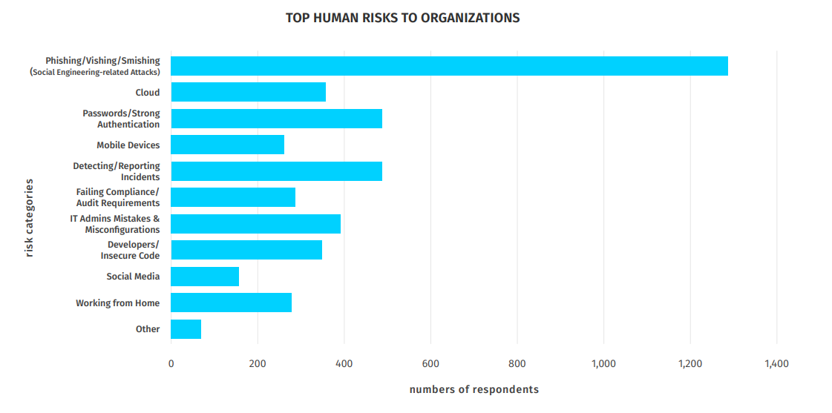
Source: Verizon 2023

Slide 9
LEARNING LEVELS
EDUCATION
TRAINING
AWARNESS
Awareness is more than Knowledge

Slide 10
Awareness is more than Knowledge
Keywords: Decision–making, remembering, recognizing, planning, perceiving, self-awareness………………..

Slide 11
WHAT IS CYBER SECURITY AWARNESS ?

Slide 13
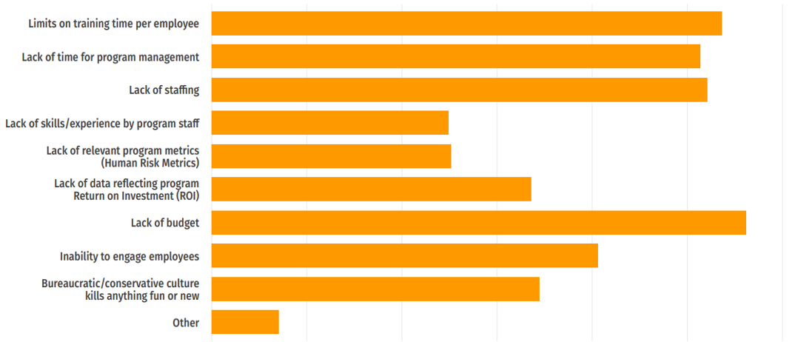
CHALLENGES
Source: Cybersecurity spending trends for 2022, IDG

Slide 14
Develop Cyber Security Awareness Program
KEEP IT SIMPLE.
STOP
THINK
ACT
Example:
Choose a strong password.
Do not open e-mail attachments without scanning.
Do not forget to log off from the application/browser.

Slide 16
BEST PRACTICE FOR DEVELOPMENT OF
SECURITY AWARENESS PROGRAM
Who are your stakeholders?
Develop and communicate the program
Understand policy/regulatory constraints/ considerations
What is the scope of this specific awareness-building effort?
Conduct post-implementation activities - How to evaluate the efficiency and benefits?

Slide 17
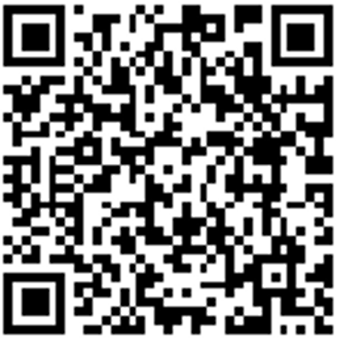
What is your Cyber Security Awareness Program?
Notes:
https://www.polleverywhere.com/activities - prvo mora da se napravi aktivacija…
u: mickov389@gmail.com
p: Ms30023002$
Кое е нивото на програмата за Cyber Security Awarness во Вашата компанија ?
Немаме - Cyber Security Awarness воопшто не се одржува
Cyber Security Awarness се одржува ад-хок во зависност од потребите
Cyber Security Awarness се одржува еднаш годишно
Cyber Security Awarness се одржува на квартално ниво
Cyber Security Awarness се одржува континутирано во текот на годината

Slide 18
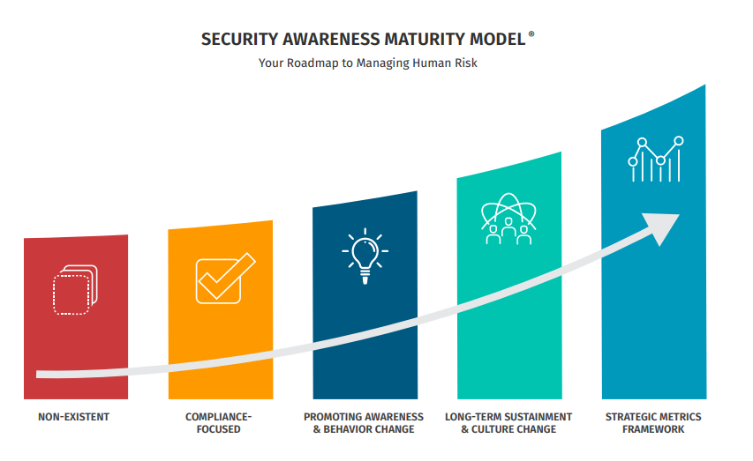
METRICS
Notes:
Кое е нивото на програмата за Cyber Security Awarness во Вашата компанија ?
Немаме - Cyber Security Awarness воопшто не се одржува
Cyber Security Awarness се одржува ад-хок во зависност од потребите
Cyber Security Awarness се одржува еднаш годишно
Cyber Security Awarness се одржува на квартално ниво
Cyber Security Awarness се одржува континутирано во текот на годината

Slide 19
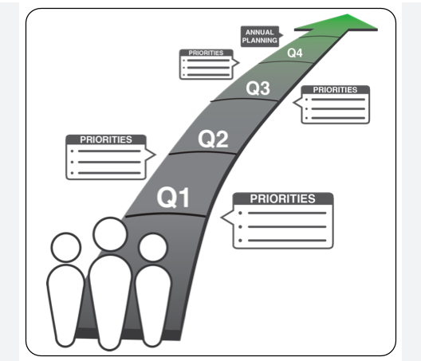
Define the (annual) plan
Continuity all-year-round activity
Identify stakeholders
Obtain support from CEO – Senior Management
Tailored to specific threats and risks that affect your organization
Be flexible for urgent topics and risks

Slide 20
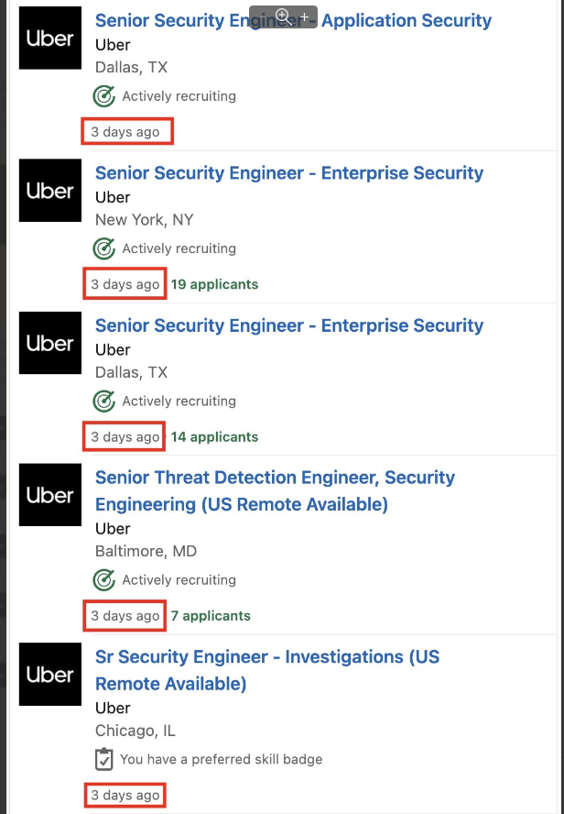
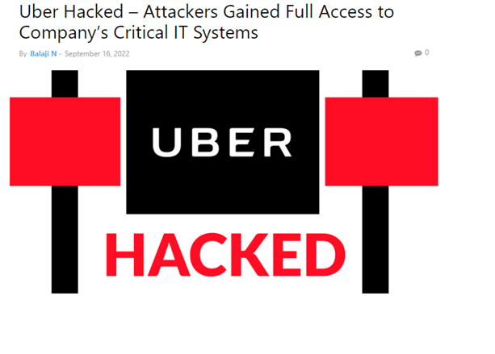
Obtain a support from
CEO – Senior Management
19.09.2022
https://thehackernews.com/2022/09/uber-claims-no-sensitive-data-exposed.html

Slide 21
Don’t forget to include the CEO – Senior Management in Security Awareness program

Slide 22
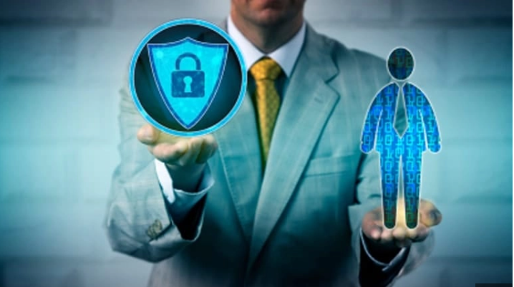
It is a time for game changer – HR to take ownership to the Cyber Security awareness program
HR’S INCREASINGLY IMPORTANT ROLE IN CYBER RISK MANAGEMENT
Cybersecurity Culture
HR is usually the first (and last) point of contact for employees and therefore plays an important role in creating and maintaining a robust cybersecurity culture.
human resource (HR)practitioners, most especially, are called to move away from their traditional administrative functions and to play a more strategic role in strengthening organizational capabilities
Notes:
https://www.marshmclennan.com/insights/publications/2020/july/hr-s-increasingly-important-role-in-cyber-risk-management.html

Slide 23
Risk-based security awareness program -based on the behavioral feedback of the users
Notes:
https://www.proofpoint.com/us/products/security-awareness-training

Slide 24
Make a interactive
Using security awareness training via various channels? (Slack, Teams, Mobile, Email….)
Provide security awareness training in various formats. (For example, live action, animation, gamification)
Testing - Security awareness training that is scenario-based or "in the moment"-based creates memories that can develop into positive habits.
Phishing simulations prompt employees to either click a link, report the phish, or do nothing.
Fedback & Reporting - Reporting is also useful for optimizing campaigns based on past results. You want to be able to see what is working well and what can be improved upon.

Slide 25
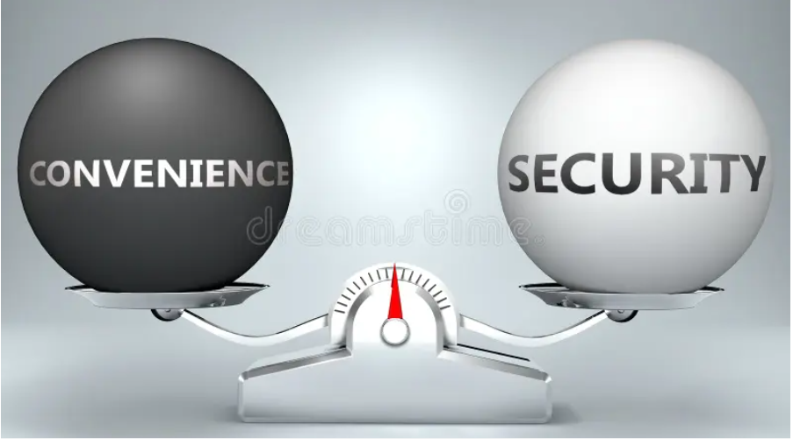
Avoids the traditional “security versus convenience” tradeoffs
Example:
Longer passwords are seen as more secure than shorter ones, but they’re also harder to remember and type
Balance: “Choosing a hard-to-guess, but easy-to-remember password is important!”
Notes:
In the context of end-user computing, we all see this trade-off daily. Longer passwords are seen as more secure than shorter ones, but they’re also harder to remember and type. Six-digit phone PINs are more secure but less convenient than four-digit ones. Multifactor authentication leveraging both a password and one-time code is more secure than just a password but annoying every time we have to switch over to the authenticator app to get that code. Requiring a PIN to unlock the authenticator app is more secure than not, but with the expense of additional steps and user annoyance.
https://blogs.vmware.com/euc/2021/11/zero-trust-avoids-the-traditional-security-versus-convenience-tradeoffs.html

Slide 26
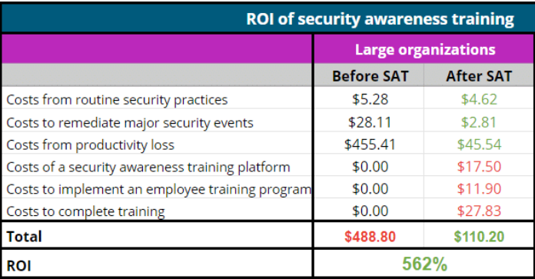
Calculate Security Awareness Training ROI
ROI = (Net benefit / Costs – 1) x 100%
security awareness training costs
Other costs
Regulatory fines
Lawsuits
Loss of revenue
Loss of brand reputation
Costs of a security awareness training platform
Costs to implement an employee training program
Costs for employees to complete training
NetBenefit = before - after
Costs
662 %
Notes:
https://resources.infosecinstitute.com/topics/security-awareness/the-roi-of-security-awareness-training-2/

Slide 27
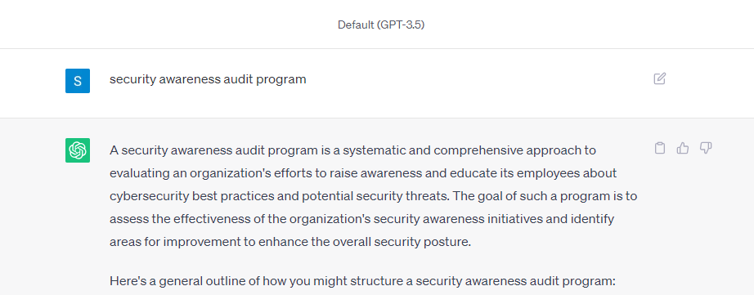
Audit role in the process
Notes:
https://www.anao.gov.au/work/performance-audit/security-awareness-and-training

Slide 28
Security Awareness Training - Audit Program
Supporting Security Awareness and Training
Is there Security awareness and training plan ?
Communication and support from senior management is established ?
Designing and Delivering Security Awareness and Training
Do you deliver departmental and role relevant security awareness training?
Is your security awareness project tailored to specific threats and risks that affect your organisation?
Do you provide security awareness training in various formats? (For example, live action, animation, gamification)
Can your users consume security awareness training via various channels? (Slack, Teams, Mobile, Email)
Monitoring the Effectiveness of Security Awareness and Training
Is the performance of your security awareness program regularly reviewed to provide evidence of employee engagement and analysis of people-based risk?
Notes:
https://www.anao.gov.au/work/performance-audit/security-awareness-and-training
https://www.metacompliance.com/cyber-security-behavioural-maturity-model

Slide 29
https://edu.iksnets.com
Mail to: edu@iksnets.com
Code: 27280923

Slide 31
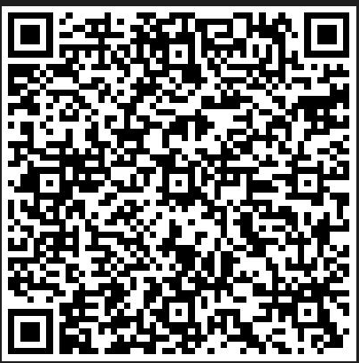
Thank you.

